Slide 1


Artificial Intelligence Group 2
Project 3: Create a chatbot in Python

Slide 2
Building an AI-Powered Diabetes Prediction System: A Design Thinking Approach
Problem Definition: The problem is to build an AI-powered diabetes prediction system that uses machine learning algorithms to analyze medical data and predict the likelihood of an individual developing diabetes. The system aims to provide early risk assessment and personalized preventive measures, allowing individuals to take proactive actions to manage their health.

Slide 3

ABSTRACT
The prevalence of diabetes has reached epidemic proportions globally, making it imperative to develop proactive solutions for early risk assessment and prevention. This abstract outlines the design thinking process for creating an AI-powered diabetes prediction system. The system aims to employ machine learning algorithms to analyze medical data and predict the likelihood of individuals developing diabetes. By focusing on functionality, user interface design, natural language processing (NLP), response planning, integration, and iterative testing and improvement, we lay the groundwork for an innovative tool that can empower individuals to manage their health effectively.

Slide 4

INTRODUCTION
Diabetes is a chronic metabolic disorder characterized by elevated blood glucose levels. Its complications can lead to severe health issues, making early detection and prevention crucial. This abstract presents a comprehensive design thinking approach for building an AI-powered diabetes prediction system. The system's goal is to leverage machine learning techniques to analyze medical data and offer personalized risk assessments and preventive measures, ultimately enabling individuals to take proactive steps towards better health.

Slide 5
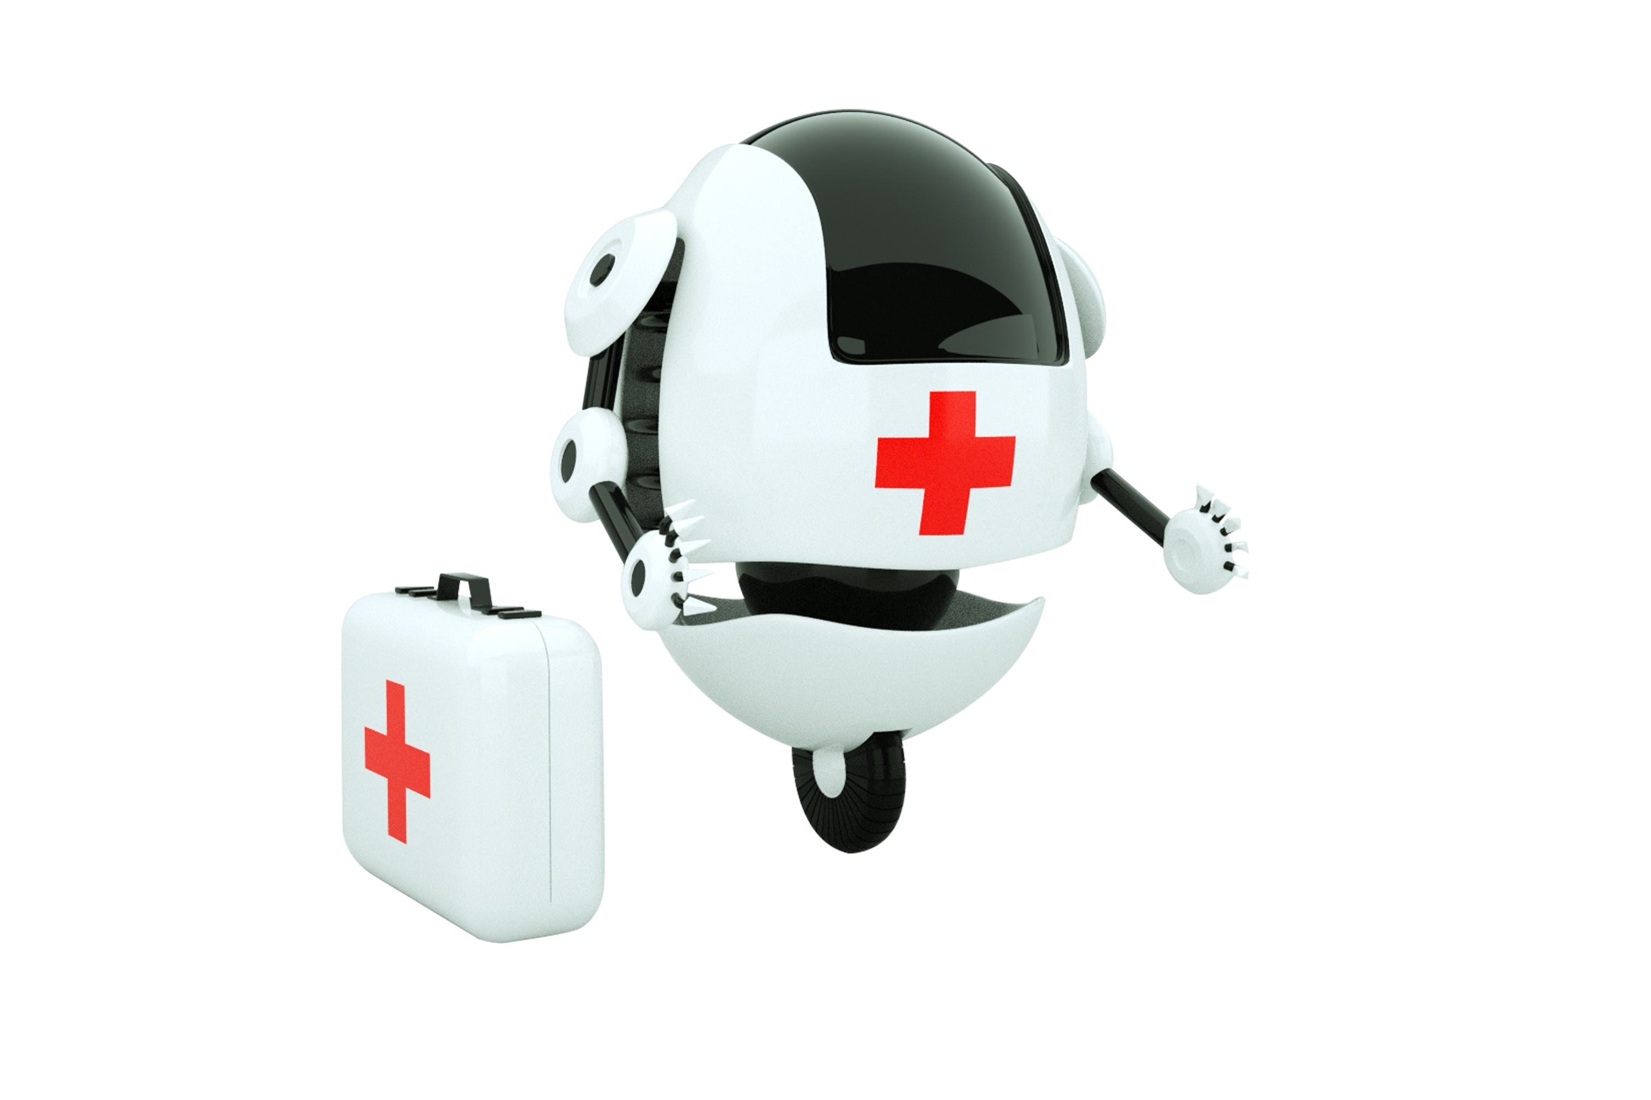
FUNCTIONALITY
To define the scope of the AI-powered diabetes prediction system's abilities, it's crucial to consider the following aspects:
1.1. Data Analysis: The system should have the capability to process various medical data types, such as patient demographics, lab results, family history, and lifestyle factors.
1.2. Predictive Modeling: Implement machine learning algorithms that can effectively predict an individual's likelihood of developing diabetes based on the input data.
1.3. Personalization: Offer personalized risk assessments and preventive measures to users based on their unique data and health profiles.
1.4. Education: Provide educational content about diabetes, its risk factors, and preventive strategies to empower users with knowledge.
1.5. Interaction: Facilitate user interactions through a chatbot interface that can answer questions, provide guidance, and direct users to appropriate resources.

Slide 6
USER INTERFACE
Designing a user-friendly interface is crucial for the success of the AI-powered diabetes prediction system:
2.1. Platform Selection: Determine whether the system will be integrated into a website, a mobile app, or both, ensuring accessibility to a wide range of users.
2.2. User-Centered Design: Prioritize user experience by creating an intuitive and visually appealing interface that promotes engagement.
2.3. Conversational Design: Design the chatbot interface to emulate natural conversations, making it easy for users to interact and receive information.
2.4. Accessibility: Ensure that the interface is accessible to individuals with disabilities, adhering to accessibility standards and guidelines.

Slide 7
NATURAL LANGUAGE PROCESSING
Implementing NLP techniques is essential to understand and process user input effectively:
3.1. Intent Recognition: Train the system to recognize user intents, whether they are seeking information, guidance, or predictive assessments.
3.2. Contextual Understanding: Enable the system to maintain context throughout conversations, allowing for more coherent and meaningful interactions.
3.3. Multilingual Support: Consider implementing multilingual support to reach a broader user base.

Slide 8
RESPONSES
Planning responses that the chatbot will offer is pivotal for providing accurate and helpful information:
4.1. Information Dissemination: Ensure that the chatbot can provide accurate answers to common questions about diabetes, its risk factors, and prevention strategies.
4.2. Personalized Recommendations: Tailor responses to individual user profiles, offering specific recommendations based on their health data.
4.3. Empathy and Support: Design responses to be empathetic and supportive, understanding the emotional aspect of discussing health-related concerns.
4.4. Resource Navigation: Direct users to appropriate resources, such as healthcare professionals, educational materials, or lifestyle modification programs.

Slide 9
INTEGRATION
Determining how the AI-powered diabetes prediction system will be integrated is crucial for its accessibility and usability:
5.1. API Integration: If integrated into a website or app, ensure that the system's functionalities are accessible via APIs to enable seamless interaction.
5.2. Cross-Platform Compatibility: Guarantee that the system works across different devices and platforms, including web browsers, iOS, and Android.
5.3. Security and Privacy: Implement robust security measures to protect users' sensitive health data and adhere to privacy regulations

Slide 10
TESTING AND IMPROVEMENT
Continuous testing and refinement are vital to ensure the system's effectiveness and user satisfaction:
6.1. User Testing: Conduct user testing to gather feedback on the chatbot's performance, interface, and overall user experience.
6.2. Machine Learning Model Updates: Regularly update the machine learning models with new data to improve prediction accuracy.
6.3. Feedback Loop: Establish a feedback loop for users to report issues, provide suggestions, and receive updates on system improvements.
6.4. Compliance and Regulations: Stay up-to-date with healthcare regulations and standards to ensure the system's compliance and ethical use of medical data.

Slide 11


CONCLUSION
In conclusion, the design thinking approach outlined in this abstract provides a comprehensive framework for developing an AI-powered diabetes prediction system. By focusing on functionality, user interface design, NLP, response planning, integration, and iterative testing and improvement, this system can become a powerful tool in the fight against diabetes. With early risk assessment and personalized preventive measures, individuals can take proactive actions to manage their health effectively, ultimately leading to improved overall well-being and reduced healthcare costs.

